Slide 1
CITY OF GREATER GEELONG Drysdale Library PRG Engagement Summary 18 November 2020

Slide 2
Engagement
Stakeholders
Landowners
Geelong Regional Library Corporation
Wadawurrung Traditional Owners Corporation
Project Reference Group
Drysdale Clifton Springs Curlewis Community Association
Bellarine Historical Society
Springdale Neighbourhood Centre
Drysdale Seniors Citizens
Festival of Glass
Local community
Council units

Slide 3
Engagement objectives…to inform design
Geelong Regional Library Corporation – service objectives
CoGG Customer Service – service objectives
Building owners – regulatory & tenant requirements
Wadawurrung – First Nations heritage considerations
Project Reference Group – stakeholders respective objectives
Local community – community survey
10min

Slide 4
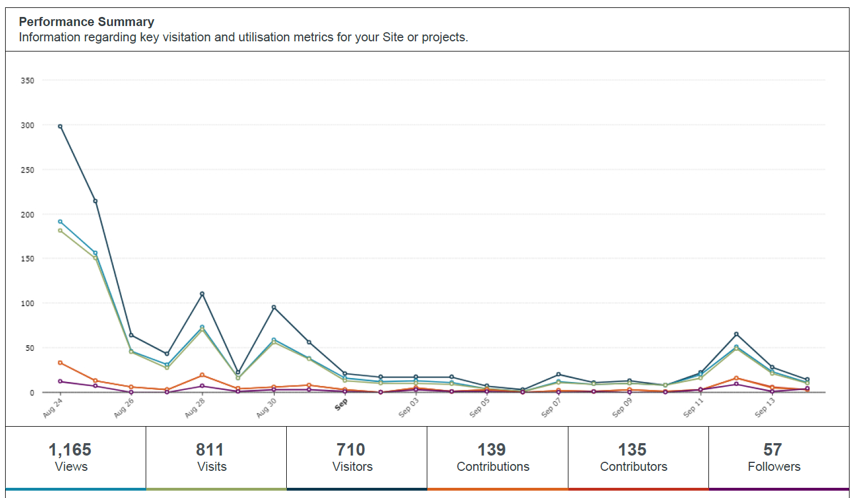
Community Survey results

Slide 5
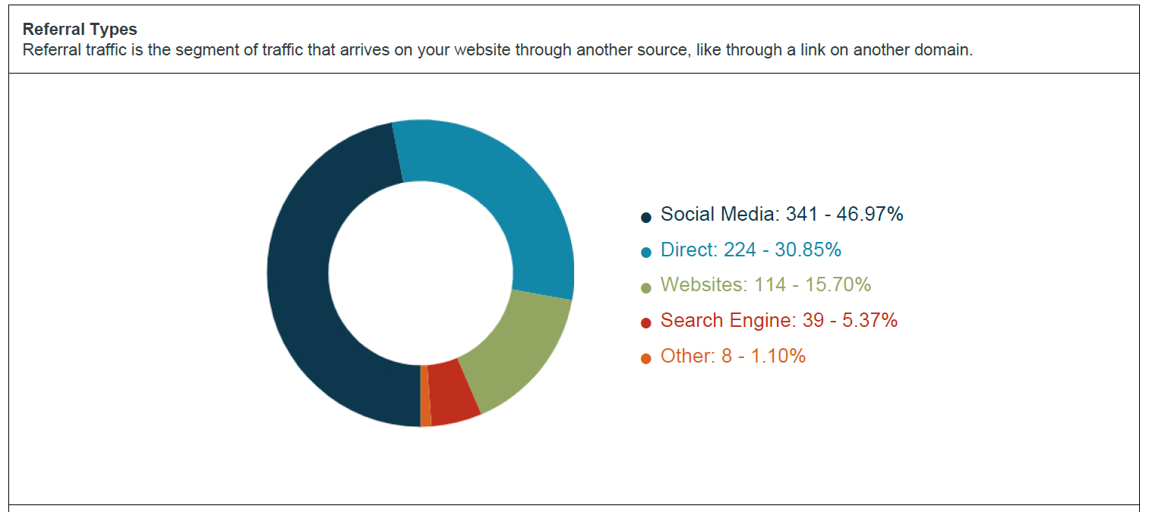
Responses from….

Slide 6
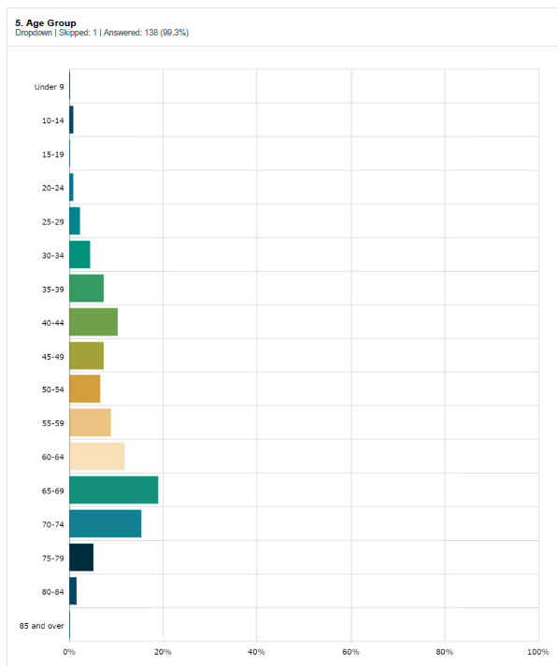
Age

Slide 7
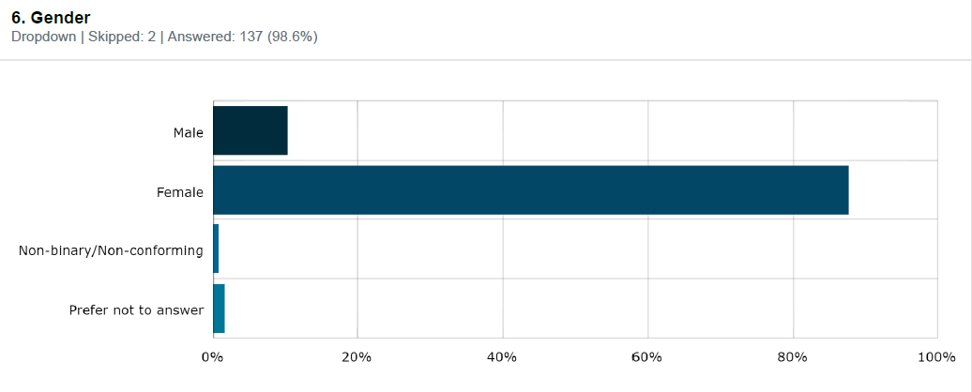
Gender

Slide 8
What do you like most about the Drysdale library?
“I think it is outdated and needs to come into the 21st century with a more modern look and feel, with plenty of spaces, room to move around and
seating for those who wish to stay awhile and read, separate computer spaces and enough toilets...”
“Good service”….”The staff - a terrific crew!”
“I like it because I can do ancestry there” “Place to gather and a place to research. Place to access a broad range of resources.”
“Friendly welcoming space. Accessible. Near other facilities. Parking available.”

Slide 9
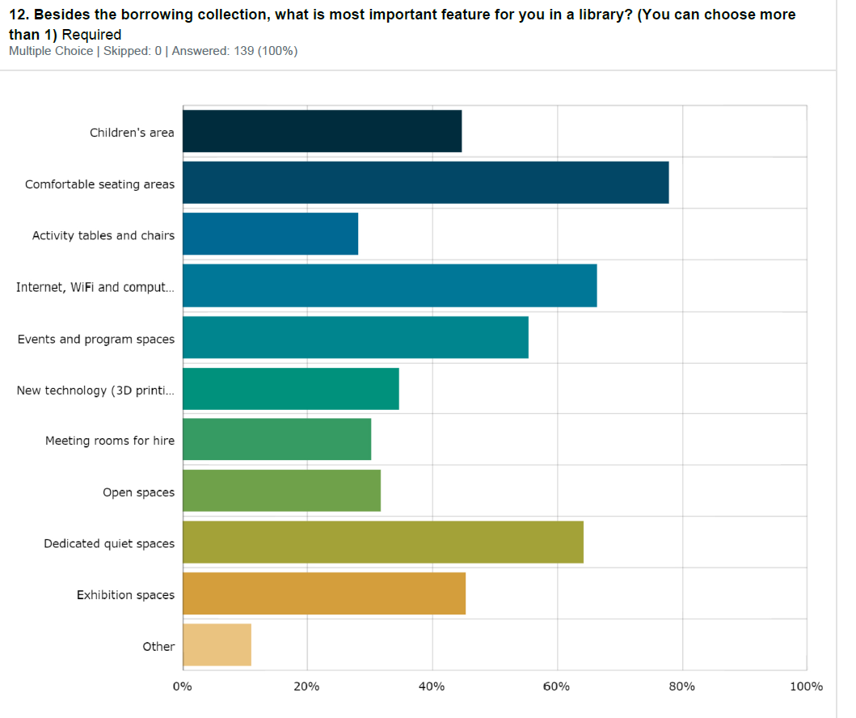
Besides the collection, what is the most important feature for you in a library?

Slide 10
Tell us three things you would like to see happen in the new Drysdale library?
“A much bigger area divided into different sections and a larger non fiction collection with lots of different seating in quiet nooks”
“Dedicated spaces for children’s events, quiet reading areas, study spaces, community meeting spaces”
“Move computer area to a quiet place.” “Private study pods”
“More parking availability” “Café” “Longer opening hours”
“Moved to a bigger building” “Bigger space within the library” “Needs more room, had to be bigger”
Design the building to suit the town, not a modern design.
“Retention of Green Spaces in the town - please don't take away our iconic green space!” “A lovely little courtyard garden to sit in and read”

Slide 11
What sort of technology would you like to see…
“Plenty of computers, printers and copiers, ipads”
3D printer, podcast studio”
The very best technologies; make it worthwhile so it is not a white elephant after two years. Innovation is key to growth.
“Internet, wifi, interactive things for children or people with disabilities.”
“Not really up with technology , but more computers in private spaces for people who do not have them at home.”

Slide 12
How do you imagine the community spaces being used?
“A quiet place to escape the hustle and noise of the outside
Available for community groups to book on an ongoing basis for meetings and events.”
“Meeting rooms - for the events that you highlight on the website/wee booklet eg. Feng Shui etc.. School trips to the library so room used for learning
Post-COVID are people going to be going back to offices or are they going to be redundant spaces?”
“Wouldn't it be great if our community could all come together in one facility. We need something to allow our young and old to cross paths and to
have the outdoors and indoors. Building on the towns iconic great space is not the answer.”

Slide 13
Thank you for your time
Questions?

